Slide 1
Python
Graphic
with Turtle
in programming

Slide 2
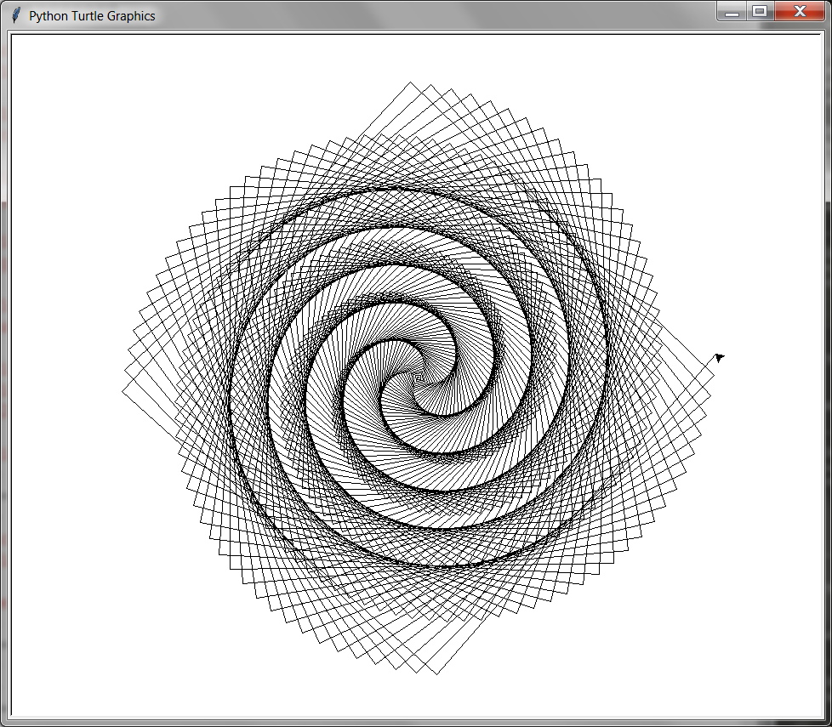
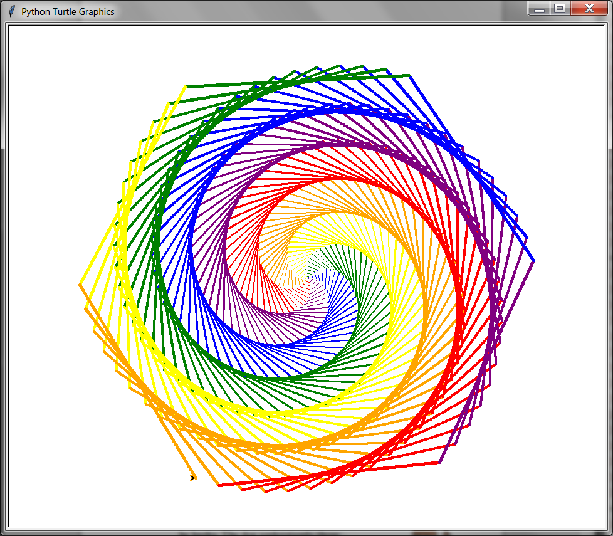
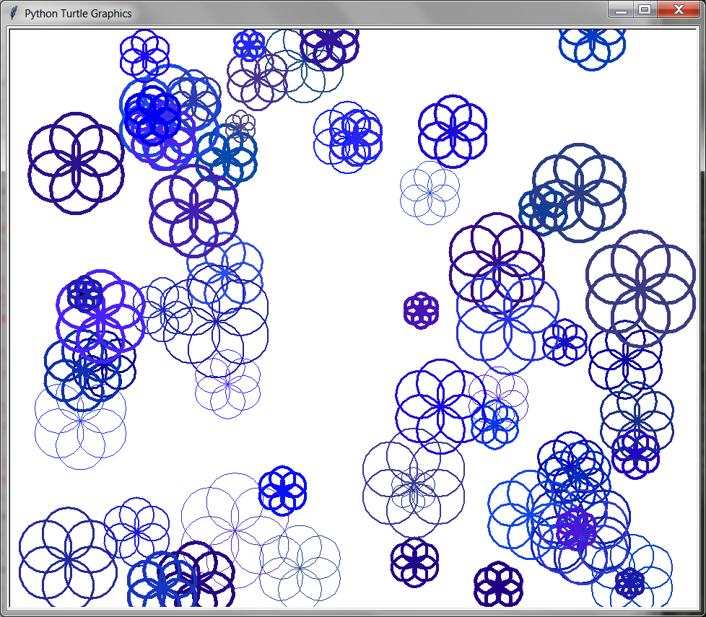
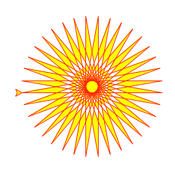
What is turtle
“Turtle” is a python feature like a drawing board, which lets you command a turtle to draw all over it!
Virtual turtles can be programmed to move around the screen. The turtle draws lines as it moves.
The "turtle" could look like the turtle animal, an arrow, or be invisible.
Turtle software was developed by Wally Feurzig, Cynthia Solomon and Seymour Papert in 1966

Slide 3
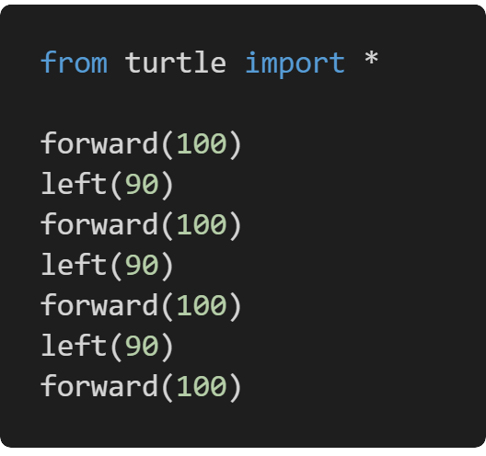
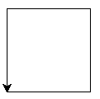
Turtle introduction
QuickStart example
The best way to learn the Python turtle is running set of codes, from the simplest to the more advanced gradually, rather than making an effort to understand the simulator fully at first.
Stuff that you are going to learn
Moving
Drawing
Color
Shapes
Screen
Loops
output
Speed
Customizing
Pattern

Slide 4
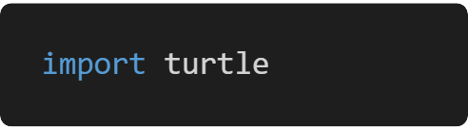
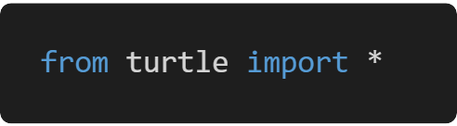
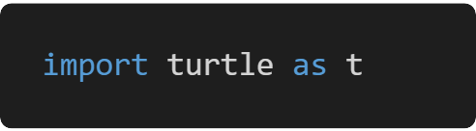
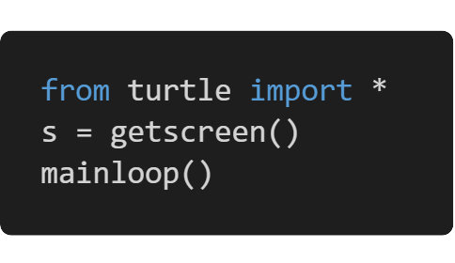
Getting Started with Turtle
The Python turtle library contains all the methods and functions that you’ll need to create your graphic. To access a Python library, you need to import it
mainloop() will stop the program from closing
1
or
or
We will use this one
2
turtle is a graphical library, which means you’ll need to create a separate window (called the screen) to carry out each drawing command. You can create this screen by initializing a variable for it.

Slide 5
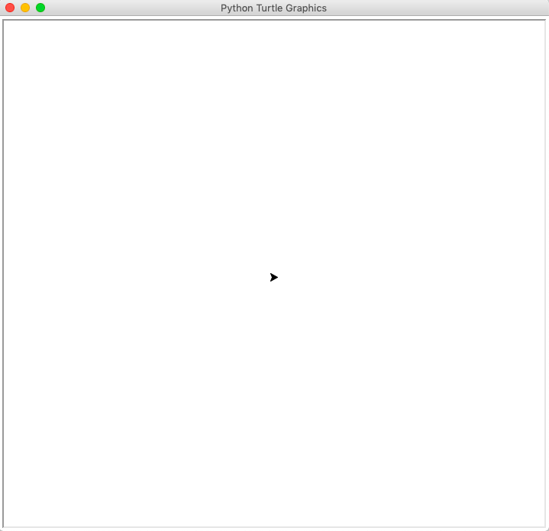
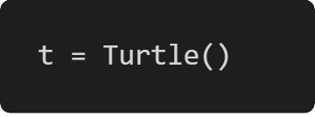
Getting Started with Turtle
This window is called the screen. It’s where you can view the output of your code. The little black triangular shape in the middle of the screen is called the turtle.
you initialize the variable t, which you’ll then use throughout the program to refer to the turtle
The screen acts as a canvas, while the turtle acts like a pen. You can program the turtle to move around the screen.
The turtle has certain changeable characteristics, like size, color, and speed.

Slide 6
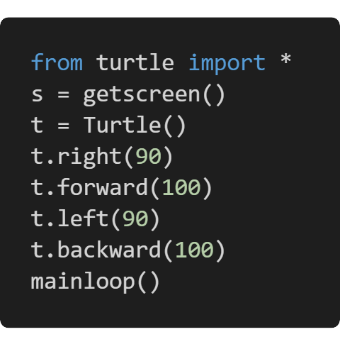
Moving the turtle
There are four directions that a turtle can move in
You can use the shortened versions of these commands as well:
t.rt() instead of t.right()
t.fd() instead of t.forward()
t.lt() instead of t.left()
t.bk() instead of t.backward()
Forward
Backward
Left
Right
You can change this direction by turning it .left() or .right() by a certain degree.

Slide 7
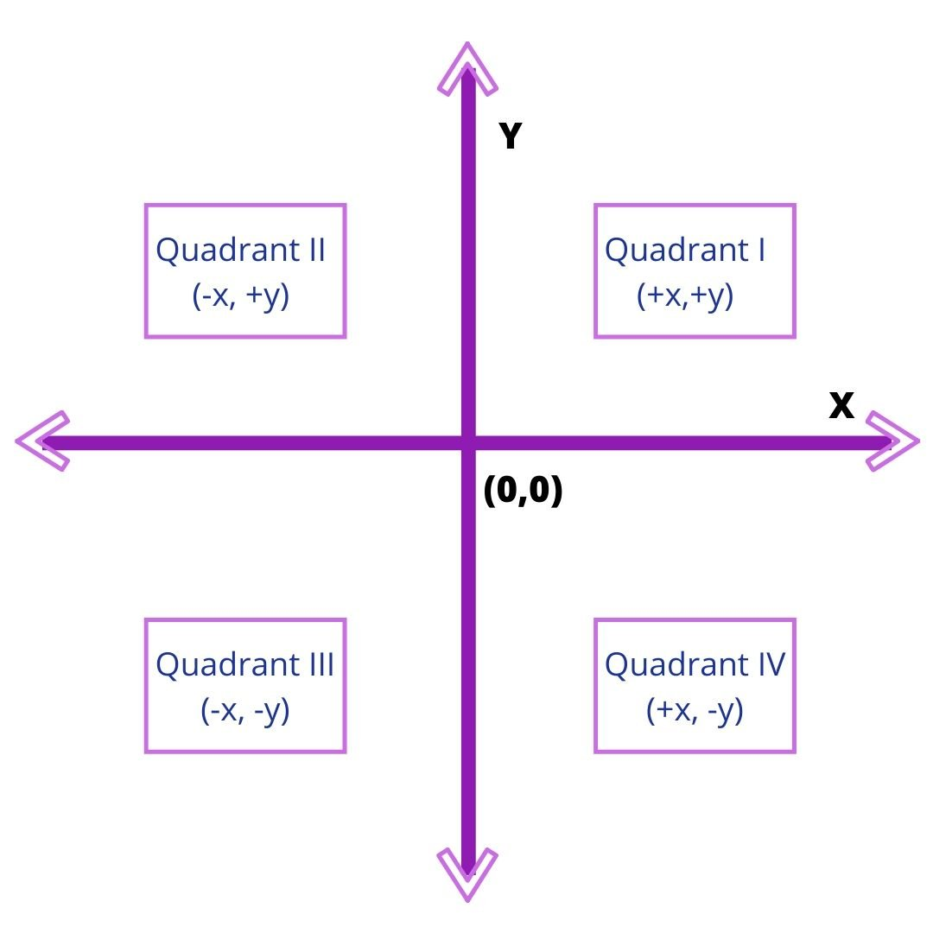
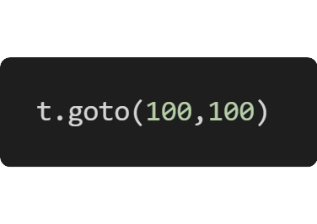
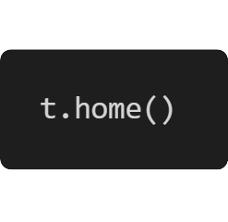
The Screen
The screen is divided into four quadrants. The point where the turtle is initially positioned at the beginning of your program is (0,0). This is called Home.
To move the turtle to any other area on the screen, you use .goto() and enter the coordinates like this

Slide 8
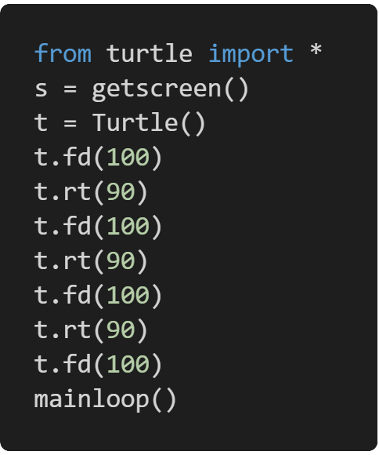
Drawing a shape
You can start by drawing polygons since they all consist of straight lines connected at certain angles
In this way, the turtle can be programmed to create different shapes and images.
Now, try drawing a rectangle, using this code as a template. Remember, in a rectangle, all four sides are not equal.

Slide 9
Drawing a pentagon
A pentagon activity
108 deg

Slide 10
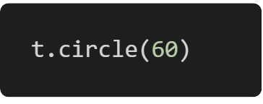
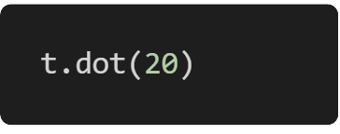
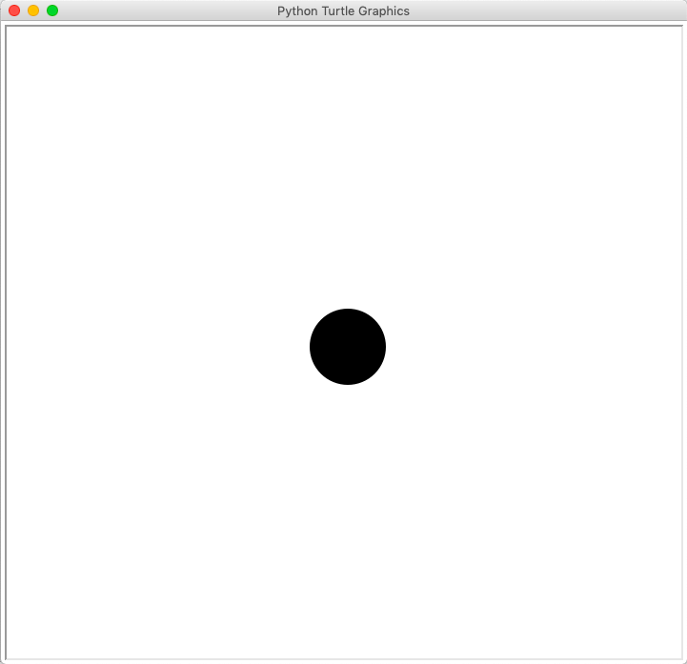
Drawing Preset Figures
the Python turtle library provides preset functions that you use. Like you can use a single command to draw a circle
The number within the brackets is the radius of the circle. You can increase or decrease the size of the circle by changing the value of its radius.

Slide 11
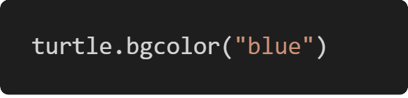
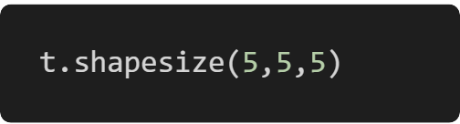
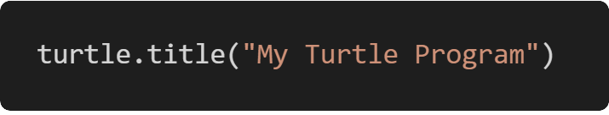
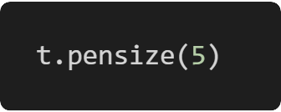
Changing the Settings
turtle always opens up a screen with a white background. However, you can change the color of the screen at any time using the following command
You can increase or decrease the size of the onscreen turtle to make it bigger or smaller. This changes only the size of the shape without affecting the output of the pen as it draws on the screen
The options are
Stretch length
Stretch width
Outline width
You can make it more personal, like "My Turtle Program", or more suitable to what you’re working on. ou can change the title of your screen with the help of this command
You can need to increase or decrease the thickness of your pen

Slide 12
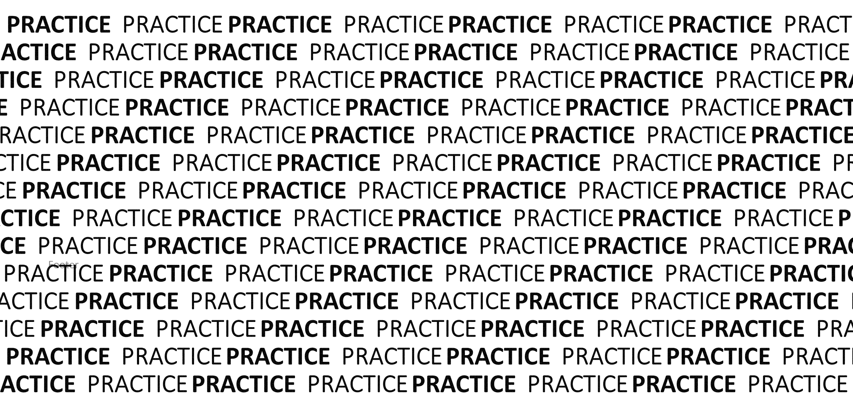
YOU NEED TO

Slide 13
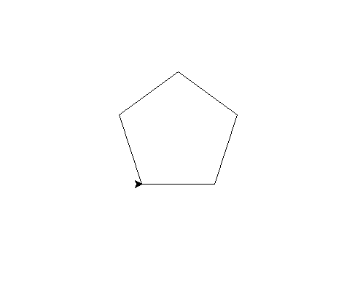
Code and learn with examples
from turtle import *
s = getscreen()
t = Turtle()
t.fd(100)
t.lt(72)
t.fd(100)
t.lt(72)
t.fd(100)
t.lt(72)
t.fd(100)
t.lt(72)
t.fd(100)
t.lt(72)
mainloop()
pentagon
Distance to move
Angle to rotate
Keep showing window

Slide 14
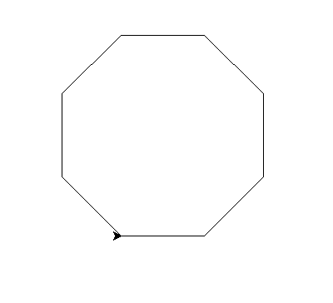
Code and learn with examples
from turtle import *
s = getscreen()
t = Turtle()
for i in range(8):
t.fd(100)
t.lt(45)
mainloop()
Octagon but with a loop
Do it 8 times
Create 100px line
Rotate 45 deg

Slide 15
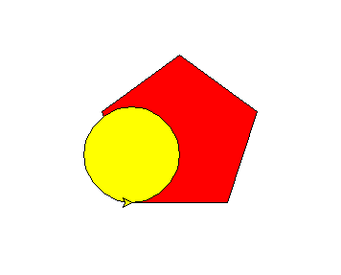
Code and learn with examples
from turtle import *
fillcolor('red') begin_fill()
for i in range(5):
fd(100)
lt(72)
end_fill() fillcolor('yellow')
begin_fill()
circle(50)
end_fill() mainloop()
Colored shapes
Set filling color to red
set before the shape creation code
Create a shape
Tell turtle to fill the color in shape
Same concept for circle color

Slide 16
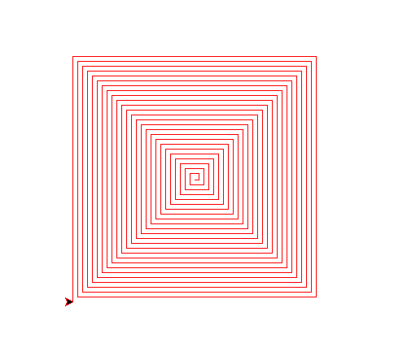
Code and learn with examples
from turtle import *
speed('slow')
pencolor('red')
for i in range(100):
fd(i*3+5) # 11
lt(90)
mainloop()
Concentric Squares
Set turtle speed to slower pace
Change line color to red
Do following 100 times
Take i, multiply by 3 and add 5, move that distance
Rotate 90 deg

Slide 17
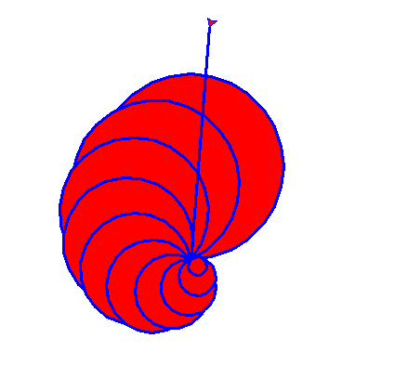
Code and learn with examples
from turtle import *
pencolor('blue')
pensize(3)
fillcolor('red')
speed('fastest')
for i in range(10,0,-1):
begin_fill()
circle(i*10)
lt(25)
end_fill()
goto(20,250)
mainloop()
Shell pattern with circles
Change line color to blue
Change pen width to 3
Set turtle speed to fastest
Run loop in reverse from 10 to 1
Make circles with value of i * 10, where i changes every turn from 10 to 1
Rotate 25 deg
Jump to new x , y position

Slide 18
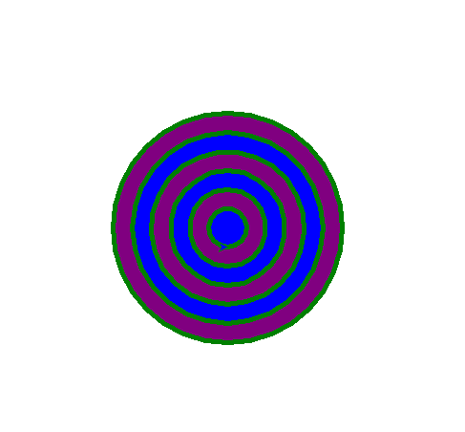
Code and learn with examples
from turtle import * s = Screen()
s.setup(1000,700) colors = ['purple','blue']
pencolor('green')
pensize(5) for i in range(6,0,-1):
penup()
setpos(0,20*i)
pendown()
fillcolor(colors[i%2])
begin_fill()
circle(20*i)
end_fill() mainloop()
Concentric circles
Change screen size using x and y pixels
List of colors
Change pen size
Move pen up from screen
Move to a position on y axis
Put pen down
Create circle with diff. radius because i changes every turn of loop

Slide 19
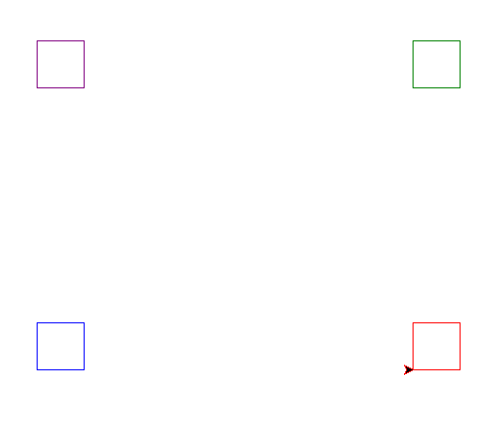
Code and learn with examples
from turtle import *
colors = ['purple','green’,
'blue','red’]
pencolor(colors[0])
penup()
goto(-200,150)
pendown()
for i in range(4):
fd(50)
lt(90)
pencolor(colors[1])
penup()
goto(200,150)
pendown()
for i in range(4):
fd(50)
lt(90)
Shape placement on screen
pencolor(colors[2])
penup()
goto(-200,-150)
pendown()
for i in range(4):
fd(50)
lt(90)
pencolor(colors[3])
penup()
goto(200,-150)
pendown()
for i in range(4):
fd(50)
lt(90)
mainloop()
BOX 3
BOX 1
BOX 4
BOX 2

Slide 20
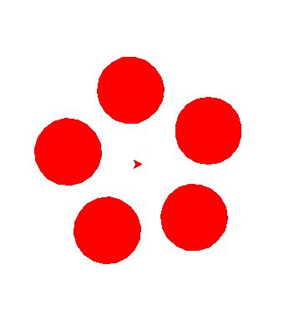
Code and learn with examples
from turtle import * s = Screen()
s.setup(500,500)
fillcolor('red')
pencolor('red')
for i in range(5):
lt(72)
penup()
fd(80)
pendown()
begin_fill()
circle(40)
end_fill()
penup()
bk(80)
pendown()
mainloop()
A flower with petals
Change screen size using x and y pixels
Rotate 72 deg
Move pen up from screen
Move turtle forward to 80
Put pen down
Set coloring
Create a circle of radius 40
Fill color in created circle
Keep the pen up again
Move turtle back 80 to mid
Put the pendown

Slide 21
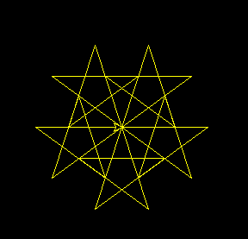
Code and learn with examples
from turtle import *
s = Screen()
s.setup(400,400)
s.bgcolor('black')
pencolor('yellow')
for i in range(5):
lt(72)
for i in range(5):
fd(100)
rt(144)
mainloop()
Star pattern
Set background to black

Slide 22
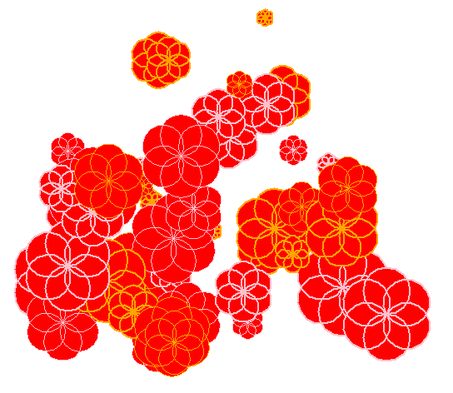
Code and learn with examples
from turtle import *
import random
s =Screen()
s.setup(500,500)
colors = ['pink','orange']
for i in range(50):
x = random.randint(-200,200)
y = random.randint(-200,200)
penup()
goto(x,y)
pendown()
# write(f'{x},{y}')
pensize(random.randint(1,2))
pencolor(colors[random.randint(0,1)])
radius = random.randint(5,30)
fillcolor('red')
begin_fill()
for i in range(6):
circle(radius)
left(60)
end_fill()
mainloop()
Import random library
Random flower pattern
Get random value for x
Get random value for y
Select a random pensize
Select a random color
Create a six sided flower

Slide 23
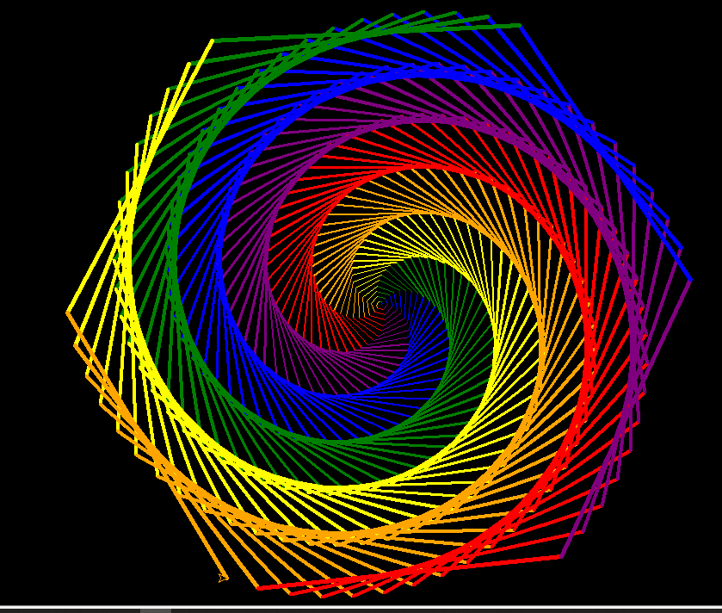
Code and learn with examples
from turtle import *
bgcolor('black')
speed('fastest')
colors = ['red', 'purple’, 'blue', 'green', 'yellow’, 'orange']
for x in range(360):
pencolor(colors[x % 6])
width(x / 100 + 1)
forward(x)
left(59)
mainloop()
Hexagonal pattern
Select a number for color
Set pen width
Make a rotation to 59 deg

Slide 24
THE END

